Slide 1

Technical exchange: Ireland’s PaMs reporting
October 2025

Slide 2
Overview
Summary of data from 2025 reporting cycle
Approach and workflow
The national system for PaMs and Projections

Slide 3
Summary of data from 2025 reporting cycle

Slide 4
Number of PaMs reported
91
56
35

Slide 5
GHG emission reductions
Achieved
Expected
Note: graph excludes LULUCF PaMs

Slide 6
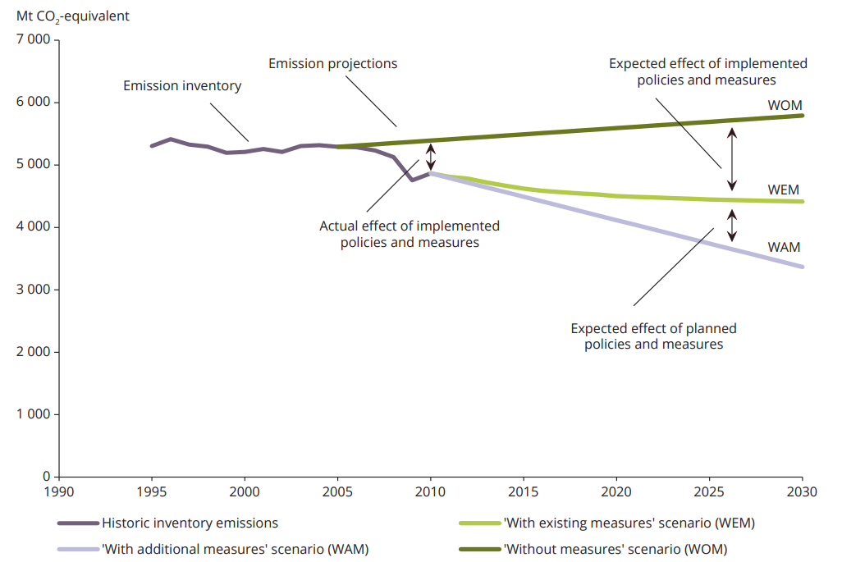
Alignment: PaMs and Projections
Source: EEA Technical report No 4/2015

Slide 7
Alignment: PaMs and Projections
Note: graph excludes LULUCF emissions and LULUCF PaMs

Slide 8
Approach and workflow

Slide 9



Approach - PaMs
Quantitative assessment of PaMs is underpinned by the same set of projected activity data and underlying scenario assumptions as those used to produce the national GHG projections
Three streams of data compilation:
Energy Efficiency PaMs
Other Energy PaMs
Non-Energy PaMs
Initiatives and supports typically delivered through SEAI
e.g. Electric Vehicle Deployment
Measures that go beyond energy efficiency including the use of renewables
Measures related to Agriculture and LULUCF and the smaller IPPU and Waste sectors

Slide 10
Three streams of data compilation
Number of PaMs by data stream and projections scenario
91
62
21
8

Slide 11


SEAI energy savings
EPA Emission Factors
Extract, Transform, Load
(Mostly manual)
PaMs Tool
Other energy and non-energy PaMs
[e.g. Ag, LULUCF, Renewables]
Transform
(Manual)
Data Processing
[MS Excel]
Load
Annex (PaMs attributes and progress)
Annex XIV
(Air Quality)
Integrated national policies and measures – GovReg

Slide 12

PaMs tool
In 2015, EPA commissioned Aether to create a PaMs tool for calculation and collation of energy PaMs
Tool updated in 2019 to generate savings from Ireland's energy PaMs for reporting under the Monitoring Mechanism Regulation
GHG and air pollutant emissions savings calculated based on data from SEAI
Energy savings (TWh/year) for each PaM, by fuel group
Fuel splits for each PaM, as percentage across solid fossil fuel, oil, gas, electricity, renewables
Sectors allocated to each PaM from industry, residential, services and transport
Emission factors applied to energy savings specific to sector, fuel and year

Slide 13
PaMs tool
The PaMs tool is based in an Excel workbook
uses the data manipulation functionalities of a relational database (Microsoft Access) to generate GHG and air quality emissions savings
The tool includes two components:
Excel workbook
to manage input data and gather output data
linked to the Access database and includes the output data through links to the database using Excel pivot tables
Access database
functions in the background to complete the data table joining and combining tasks
performs queries on the input data taken from the Excel workbook, the results of which are included in the Excel workbook
the Access database does not need to be open to update results

Slide 14
SEAI energy savings
EPA Emission Factors
Extract, Transform, Load
(Mostly manual)
PaMs Tool
Other energy and non-energy PaMs
[e.g. Ag, LULUCF, Renewables]
Transform
(Manual)
Data Processing
[MS Excel]
Load
Annex (PaMs attributes and progress)
Annex XIV
(Air Quality)
Integrated national policies and measures – GovReg

Slide 15
Other energy PaMs
Impacts of these PaMs calculated through counterfactuals and assumptions around fossil fuel displacement:
Renewables - Electricity Generation: Renewable electricity displacing the use of natural gas
Renewables - Transport: Biodiesel and bioethanol displacing the use of petrol and diesel
Renewables - Heat: Consumption of renewable heat displacing the consumption of oil
Biomethane: Consumption of biomethane displacing the consumption of natural gas
Energy demand data sourced from National Energy Projections produced by SEAI
Fossil fuel emission factors sourced from National GHG Inventory

Slide 16
Non-energy PaMs
Agriculture and LULUCF policies and measures are isolated in the GHG projections by the sectoral expert
e.g. the planned measure ‘Extended forestry rotation’ is linked to the LULUCF accounting category ‘Managed forest land’
Difference between WEM and WAM GHG projection for this category captures a bigger source of emissions under WEM moving to a smaller source under WAM (the effect of extended forestry rotation)

Slide 17
SEAI energy savings
EPA Emission Factors
Extract, Transform, Load
(Mostly manual)
PaMs Tool
Other energy and non-energy PaMs
[e.g. Ag, LULUCF, Renewables]
Transform
(Manual)
Data Processing
[MS Excel]
Load
Annex (PaMs attributes and progress)
Annex XIV
(Air Quality)
Integrated national policies and measures – GovReg

Slide 18

Unique PaM IDs
Reporting field requires that each PaM has a unique ID
Ensures consistency across reporting cycles
Useful for lookup formulas to pull data from data processing files to import template

Slide 19
PaMs Improvement process
Continuing to develop and expand work on PaMs
Annual QA/QC feedback from the ETC-CM acts as a starting point
Ongoing improvements include:
Enhancing alignment with national GHG projections
methodology updates for in-house calculations
improving ex-post analysis of PaMs
updating qualitative information behind each PaM (e.g., descriptions, assumptions, links to Union dimensions and policies)
process documentation

Slide 20
The national system for PaMs and Projections

Slide 21
Institutional arrangements
Ireland’s Environmental Protection Agency (EPA) designated as the national entity with overall responsibility for reporting on policies and measures (PaMs) and GHG projections
The Minister for Climate, Energy and the Environment has overall responsibility for climate change policy and coordination of the development of the national policies and measures in climate change mitigation and adaptation
The EPA works with the following organisations to clearly understand the assumptions, methodologies and models underpinning projections and PaMs associated with relevant sectors:
Sustainable Energy Authority of Ireland (SEAI)
Economic and Social Research Institute (ESRI)
Teagasc (The Irish Agriculture and Food Development Authority)
Government Departments

Slide 22
Stakeholder engagement
Engagement process is well established
Main stakeholders consulted in the preparation of GHG emission projections and Policies and Measures are:
Sustainable Energy Authority of Ireland (SEAI)
Economic and Social Research Institute (ESRI), with input from Department of Finance
Government Departments (Climate, Energy and the Environment , Enterprise Trade and Employment, Housing Local Government and Heritage, Transport)
Teagasc (The Irish Agriculture and Food Development Authority) and Department of Agriculture, Food and the Marine

Slide 23
Alignment with national inventory system
National system for PaMs and projections builds on the National Atmospheric Inventory System (NAIS) for Ireland which was established by Government Decision in 2007
The EPA has developed and implemented practices in the development of greenhouse gas emission projections which broadly follow the processes and arrangements in place for the national inventory system:
Incorporation of the projections data processing into the national emission inventory file structures
Development of QA/QC procedures like those in place for national emission inventories
Extending the remit of national emission inventory system Memoranda of Understanding with key data providers to include the supply of activity data for national greenhouse gas and air pollutant emission projections

